Slide 1
MABARA
MATERIAL DIRECTION
SHAO KAO / INTERIOR PROPOSAL
Warm concrete
#6B655B
Two shophouse concepts
with a single material language
Terracotta
#B9684E
Olive accent
#8C8D5E
Brass detail
#C6A66A
A middle-low price shao kao environment: practical planning, warm tactility, clear circulation, and details that feel made rather than decorated.
Timber table
#8D6B4E
Cream linework
#E7DFD2
CONCEPT 01 / 2 RUKO
CONCEPT 02 / 1 RUKO
DESIGN INTENT
MABARA / SHAO KAO / 2026

Slide 2
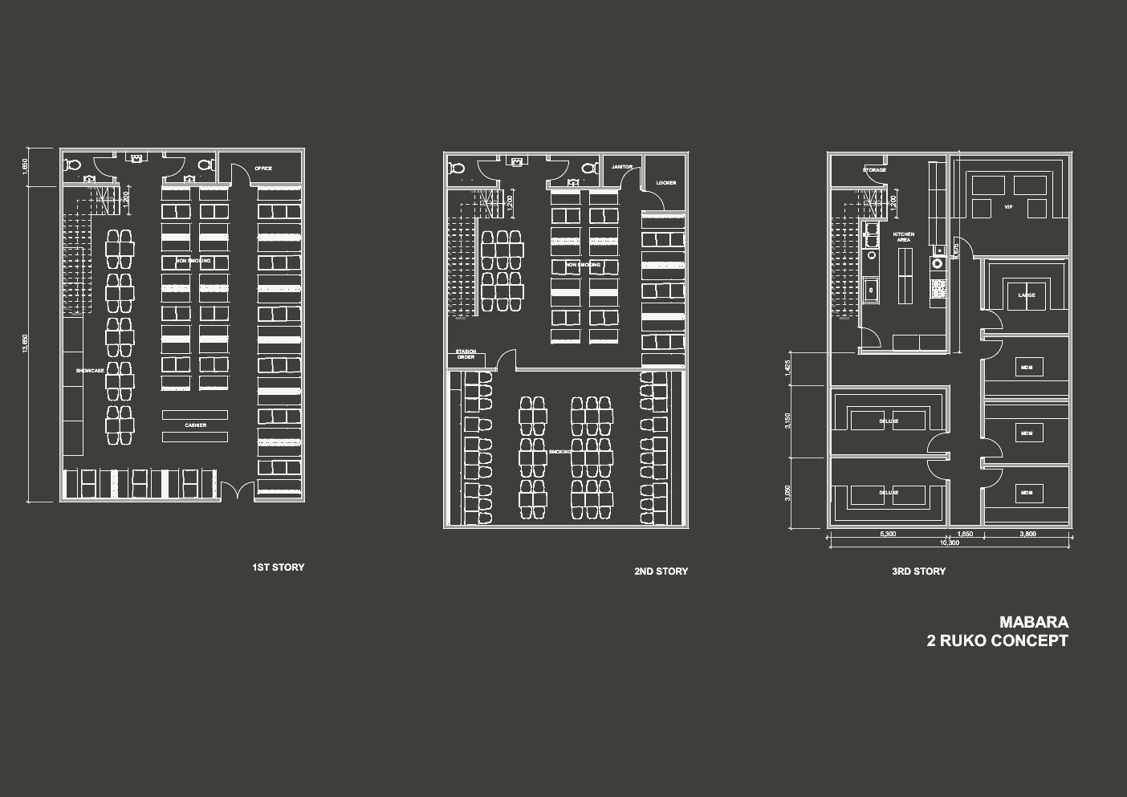
CONCEPT 01
02
2 Ruko / planning concept
A larger dining program with a dedicated kitchen and room mix above
READING THE PLAN
Two connected shophouses allow the dining floor to separate
non-smoking and smoking zones while the upper level carries private rooms.
MATERIAL APPLICATION
• Warm concrete walls
• Charcoal metal frames
• Terracotta upholstery
• Olive touchpoints
• Brass only at handles and trims
• Timber communal tables
The source plan remains the authority for all geometry. Color and material notes are proposal layers only.
CONCEPT 01
MABARA / SHAO KAO / 2026

Slide 3
CONCEPT 01 / FLOOR-BY-FLOOR
03
Two-ruko operating stack
Exact source plan with proposed atmosphere and material cues
01 / DINING FLOOR
Non-smoking dining, showcase, cashier and service support sit on the first level. Use warm concrete as the visual field, with terracotta seat pads to give the dense plan a clear rhythm.
02 / MIXED DINING
The second floor keeps the same seating logic and adds a smoking zone, order station, janitor and locker functions. Charcoal metal keeps service elements visually quiet.
03 / KITCHEN + ROOMS
The third floor concentrates the kitchen and distributes VIP, large, deluxe and medium rooms. Brass stays limited to room numbers, pull handles and small edge trims.
CIRCULATION / RETAINED
MATERIAL LAYER
NO LUXURY FINISH
CONCEPT 01 / FLOOR-BY-FLOOR
MABARA / SHAO KAO / 2026

Slide 4
CONCEPT 01 / DETAIL DIRECTION
04
Working details for a practical shao kao interior
Furniture and lighting proposals sized for repetition and maintenance
COMMUNAL TABLE
LINEAR PENDANT
BANQUETTE MODULE
MATERIAL BOARD
Concrete
#6B655B
Timber top / black frame / wipeable clear coat
2700K warm light / black body / brass cap
Terracotta upholstery / olive back cushion
Upholstery
#B9684E
Accent
#8C8D5E
FURNITURE DIRECTION
LIGHTING DIRECTION
Keep every piece robust, compact and easy to replace. Prioritize timber where guests touch the furniture; use black powder-coated steel below to withstand daily cleaning and impact.
Use a low-glare warm architectural layer over the plan. Pendants mark tables, concealed strips wash the concrete, and room entries receive a small brass identification detail.
SPECIFICATION NOTE
Middle-low price positioning: use fewer materials, repeat them well, and reserve brass for the moments guests naturally notice.
CONCEPT 01 / DETAIL DIRECTION
MABARA / SHAO KAO / 2026

Slide 5
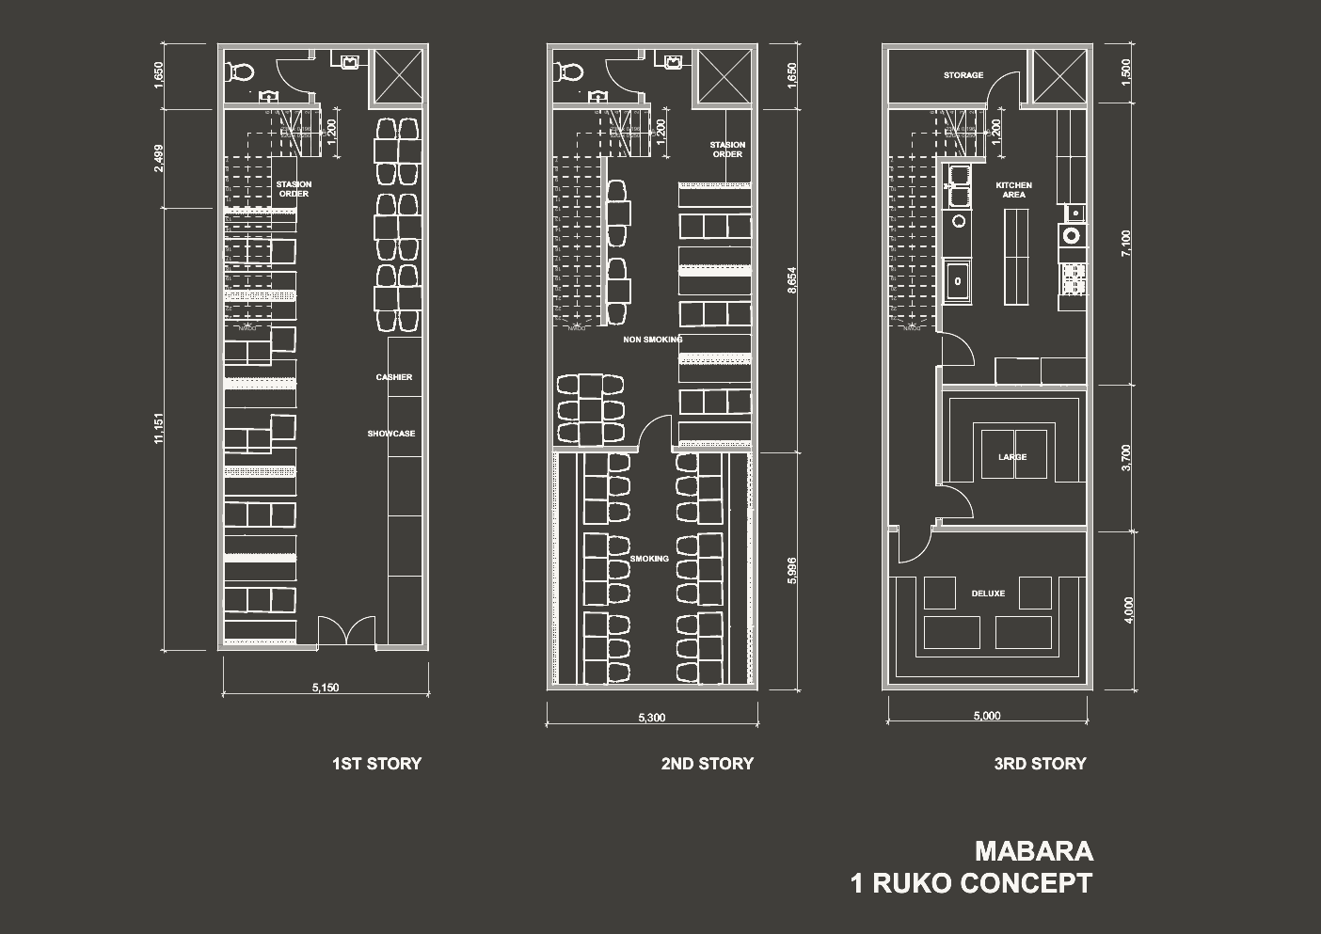
CONCEPT 02
05
1 Ruko / planning concept
A compact single-frontage restaurant with a clear vertical sequence
READING THE PLAN
One shophouse compresses the program into a direct ground-floor arrival,
separate dining levels, and a kitchen plus private-room floor above.
MATERIAL APPLICATION
• Warm concrete walls
• Charcoal metal frames
• Terracotta upholstery
• Olive touchpoints
• Brass only at handles and trims
• Timber communal tables
The source plan remains the authority for all geometry. Color and material notes are proposal layers only.
CONCEPT 02
MABARA / SHAO KAO / 2026

Slide 6
CONCEPT 02 / FLOOR-BY-FLOOR
06
Single-ruko operating stack
Exact source plan with the same material language at a tighter scale
01 / ARRIVAL + DINING
The first floor carries station order, cashier, showcase and non-smoking seating. A warm concrete base and terracotta upholstery make the narrow plan feel intentional rather than crowded.
02 / SPLIT ATMOSPHERE
The second floor separates non-smoking and smoking areas while keeping the stair as the main visual anchor. Use olive accents to identify the quieter circulation edge.
03 / KITCHEN + PRIVATE ROOM
The top level places kitchen support beside large and deluxe rooms. Keep the kitchen practical and visible through material contrast rather than premium appliances or decorative cladding.
COMPACT / CLEAR
REPEATABLE KIT
MIDDLE-LOW
CONCEPT 02 / FLOOR-BY-FLOOR
MABARA / SHAO KAO / 2026

Slide 7
CONCEPT 02 / DETAIL DIRECTION
07
Compact details with a strong front door identity
Furniture and lighting proposals for the one-ruko footprint
WALL-MOUNTED TABLE
STAIR LIGHT
ROOM ENTRY
MATERIAL BOARD
Timber
#8D6B4E
Timber fold-down edge / black bracket / compact footprint
Continuous warm strip / charcoal handrail / olive marker
Terracotta felt panel / brass number / black frame
Brass
#C6A66A
Concrete light
#E7DFD2
FURNITURE DIRECTION
LAMP + SIGNAGE DIRECTION
Use smaller two- and four-seat tables where circulation tightens. The frame language stays consistent with the two-ruko concept so both concepts can share a procurement package.
Make the stair and room entries legible with one continuous warm light language. A small brass number plate gives orientation without creating a luxury hotel mood.
COMPETITION POSITION
The one-ruko option wins through discipline: the same palette, a tighter furniture kit, and a clear vertical experience from entry to private room.
CONCEPT 02 / DETAIL DIRECTION
MABARA / SHAO KAO / 2026

Slide 8
COMPARISON
08
Two plans, one recognizable MABARA language
The proposal keeps the source geometry fixed and changes only the scale of the operating kit
2 RUKO
1 RUKO
More dining capacity
Clear non-smoking / smoking split
Dedicated kitchen + larger room mix
Compact operational stack
Direct arrival and vertical wayfinding
Smaller, repeatable furniture kit
Best when the brief values seating variety and a fuller private-room program.
Best when frontage and build economy are the primary constraints.
SHARED MATERIAL LOGIC
Warm concrete / charcoal metal / terracotta upholstery / olive accents / brass details / timber tables / warm architectural lighting
CONCEPT COMPARISON
MABARA / SHAO KAO / 2026

